Slide 1

Detecting Deep Fake Faces
By: Rahul torlapati
Data 606
https://github.com/rahultorlapati/DATA606

Slide 2

BACKGROUND
Deepfakes (portmanteau of “deep learning” and “fake”) use a form of artificial intelligence called deep learning to make images of fake events, hence the name Deepfake
They are fake videos, images or audio recordings that look and sound like the real thing.

Slide 3




DATASETs
There are 202,599 images in the CelebA dataset and 1,000,000 images in the Fake Faces datasets.
Dimensions for images from CelebA are 224X224 and images from fake faces are 1024X1024

Slide 4
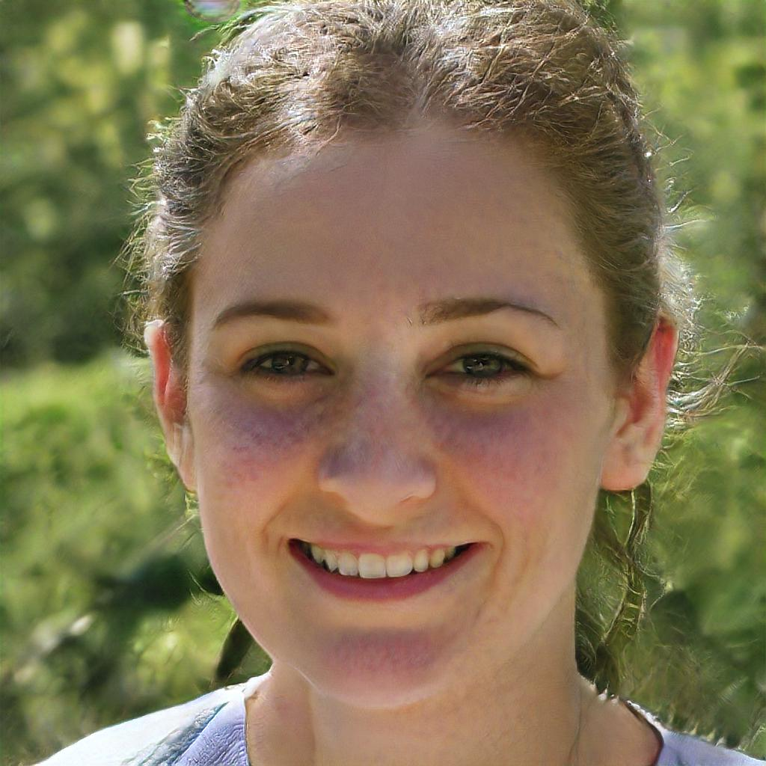
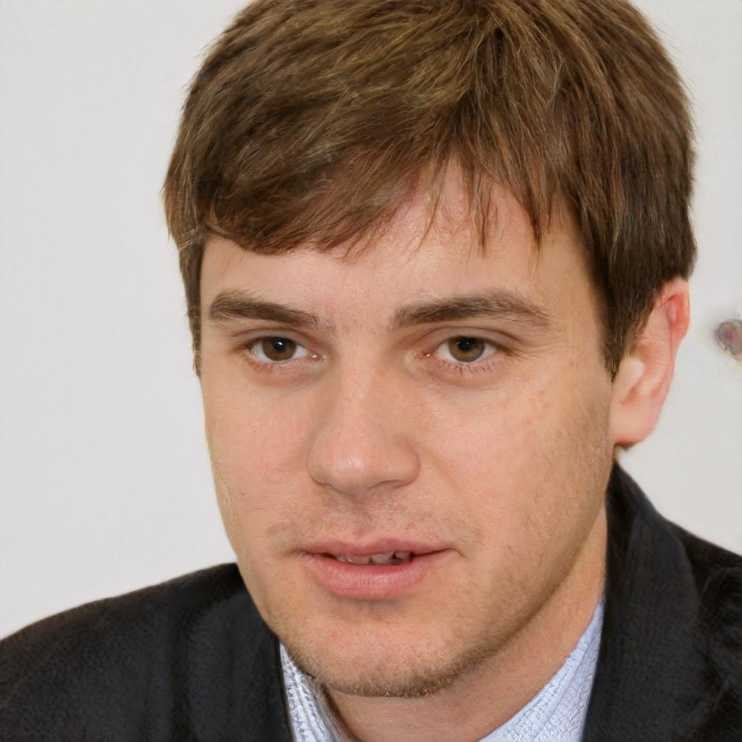


Fake Faces DATASET
Fake faces dataset is generated by NIVIDIA Research Lab using Generative Adversarial Networks GANs.
GANs were introduced in a paper by Ian Goodfellow along with Yoshua Bengio and other researchers at the University of Montreal in 2014.

Slide 5
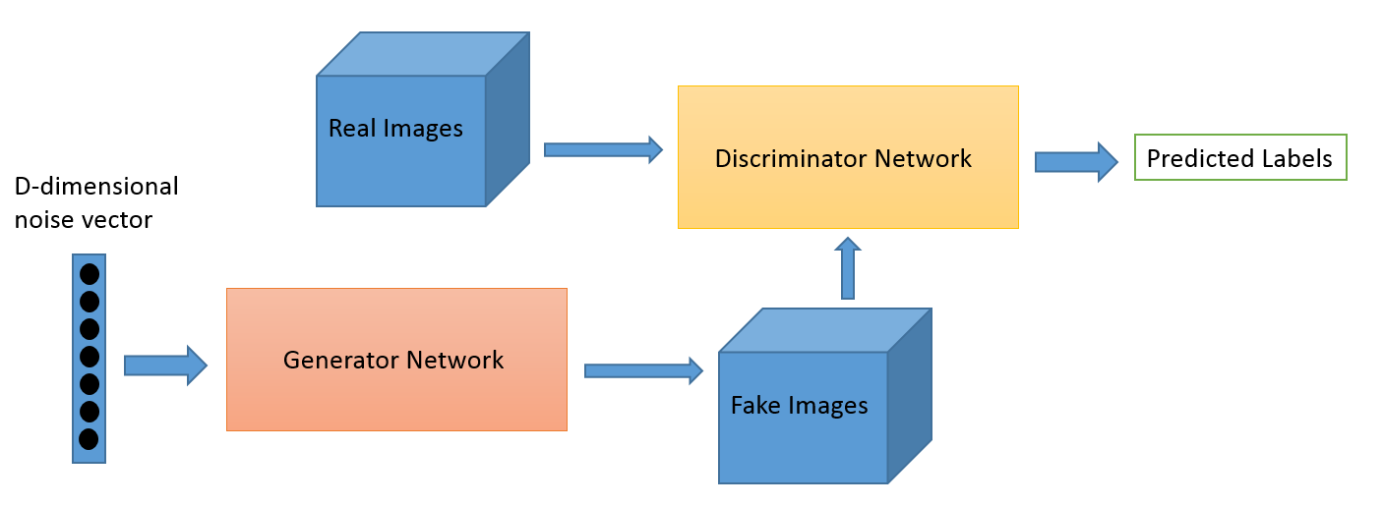
Fake Faces DATASET
One neural network, called the generator, generates new data instances, while the other, the discriminator, evaluates them for authenticity; i.e. the discriminator decides whether each instance of data that it reviews belongs to the actual training dataset or not

Slide 6
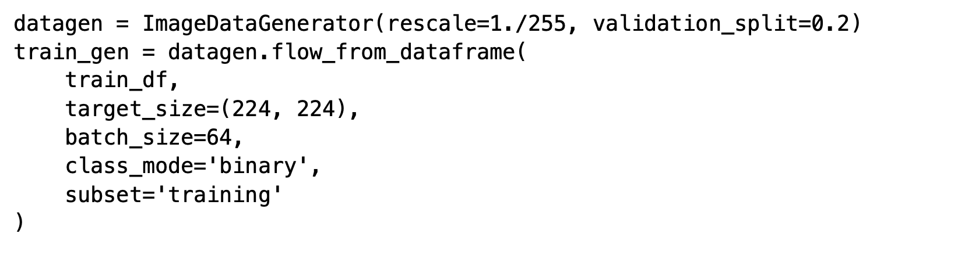
PREPROCESSING
This class generates batches of tensor image data with real-time data augmentation. The data will be looped over in batches.

Slide 7
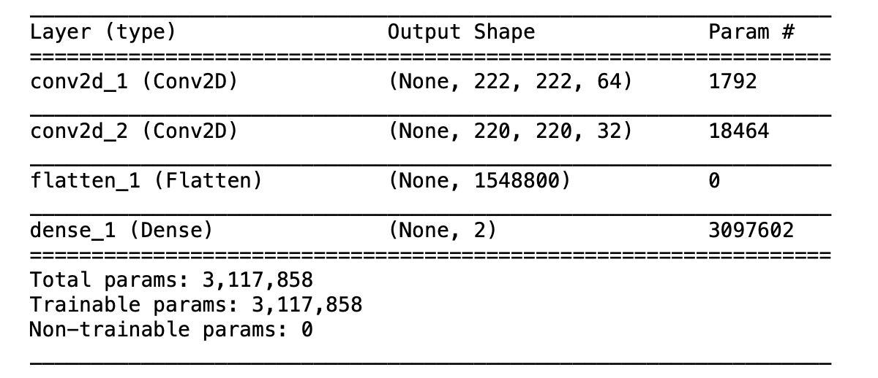
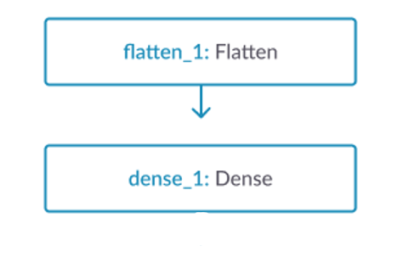
Model Building – SIMPLE CNN
The model type that we will be using is Sequential. Sequential is the easiest way to build a model in Keras. It allows you to build a model layer by layer. We use the add() function to add layers to our model.

Slide 8
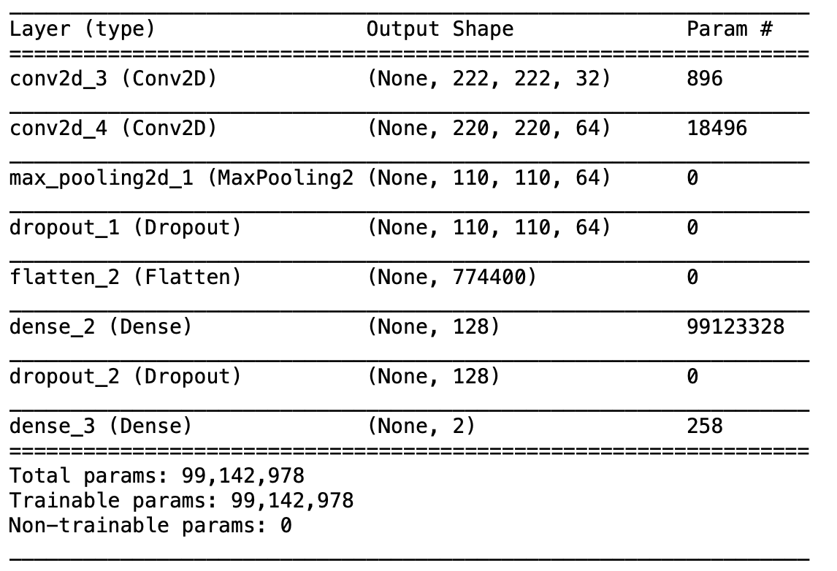
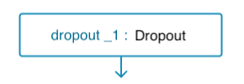
Model Building – COMPLEX CNN

Slide 9
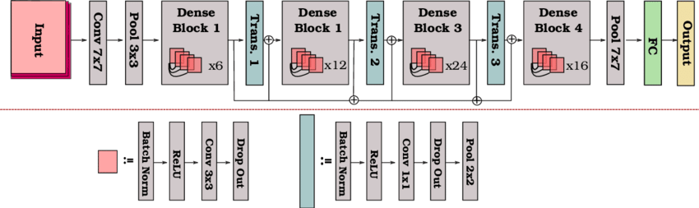
Model Building - DENSENET

Slide 10
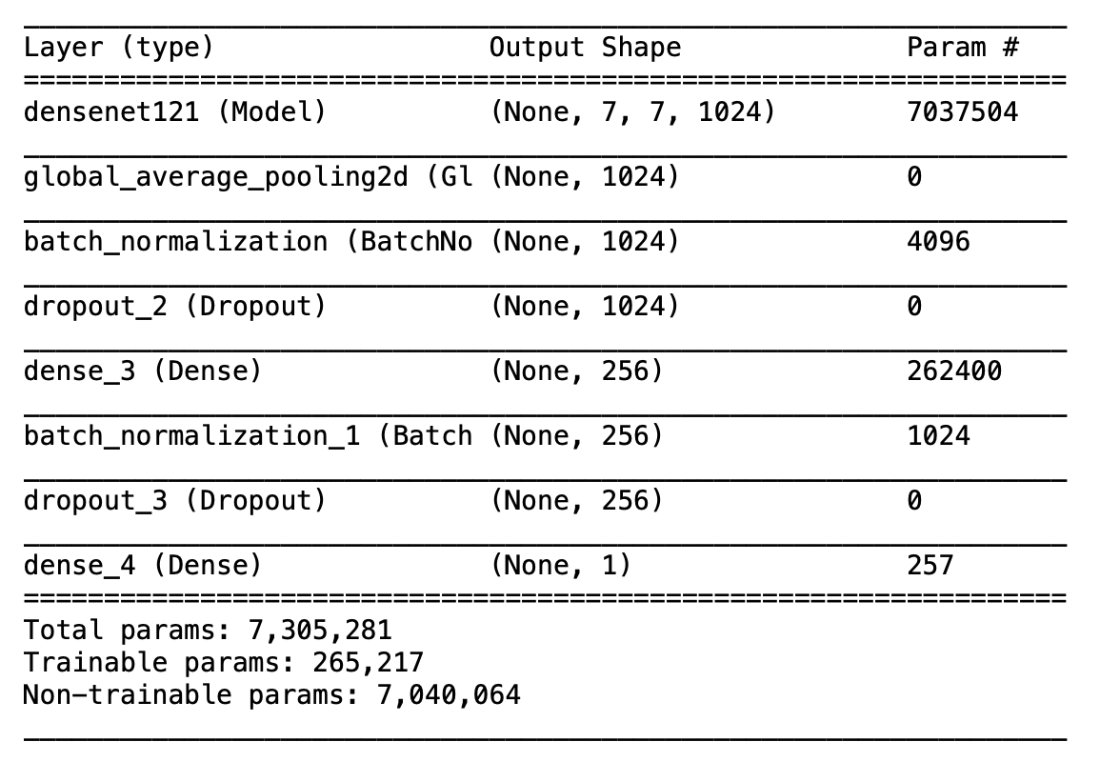
Model Building - DENSENET
Results:
Each epoch took around 840sec
Best val_loss 0.000201

Slide 11
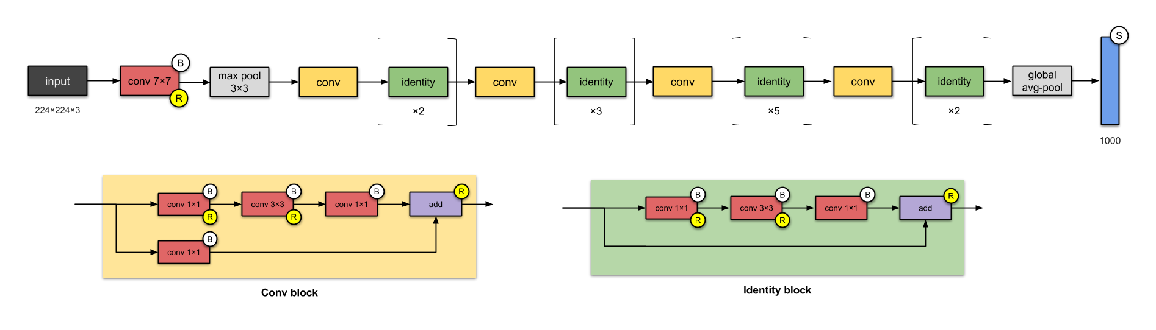
Model Building - RESNET

Slide 12
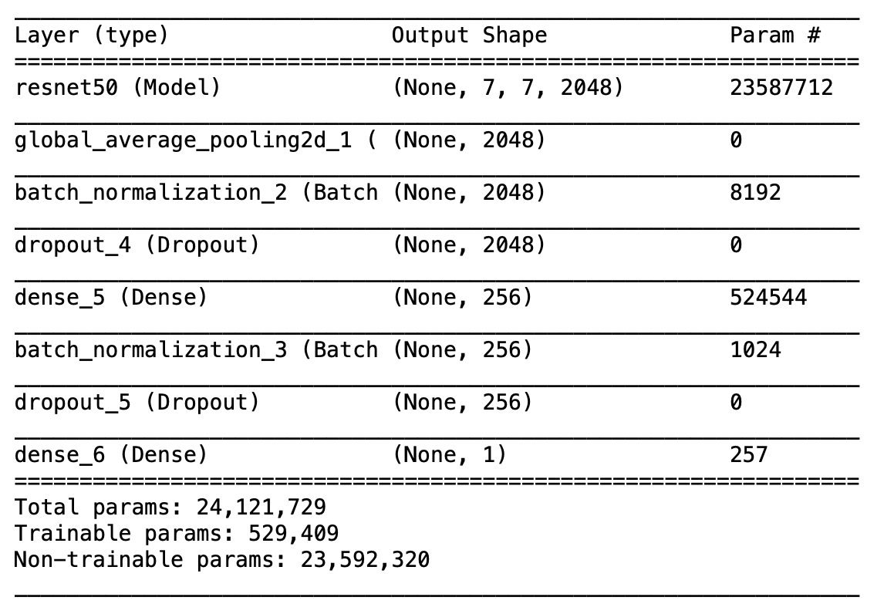
Model Building - RESNET
Results:
Each epoch took around 570sec
Best val_loss 0.1152

Slide 13
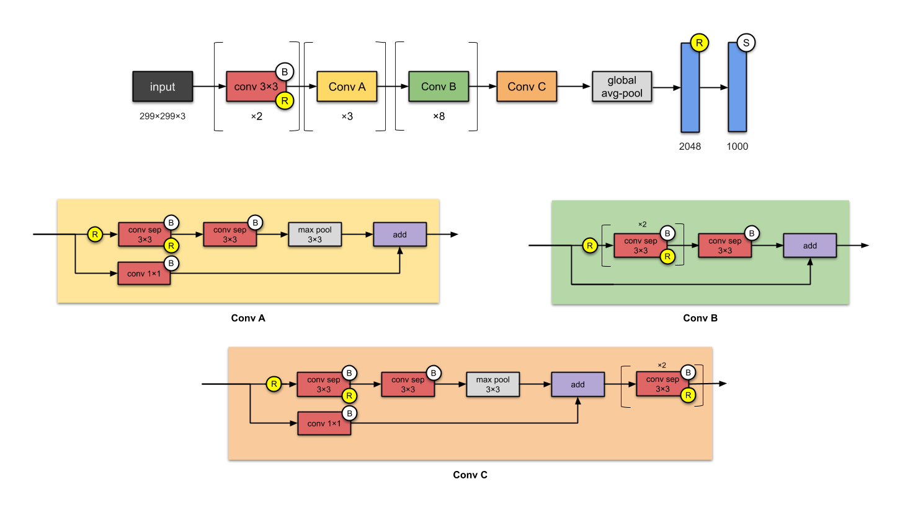
Model Building - XCEPTION

Slide 14
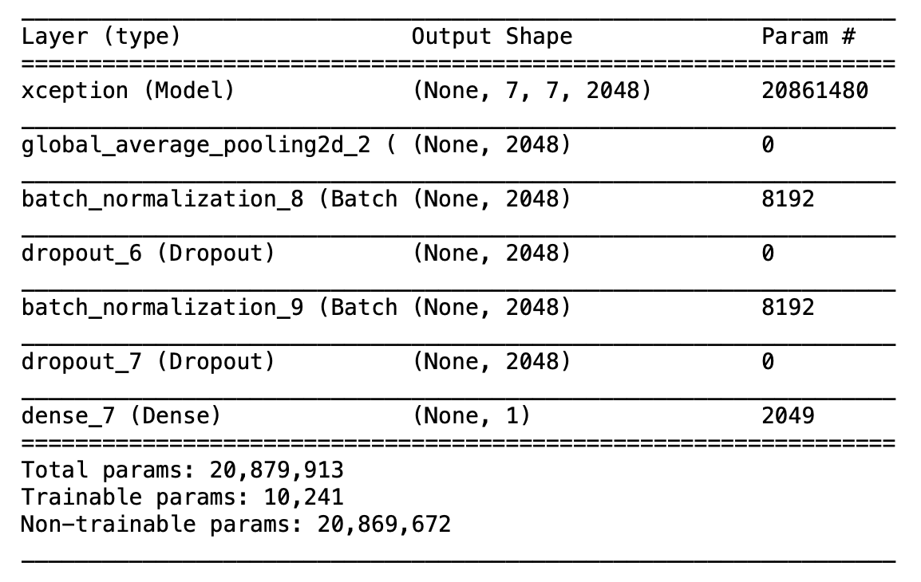
Model Building - XCEPTION
Results:
Each epoch took around 520sec
Best val_loss 0.00844

Slide 15
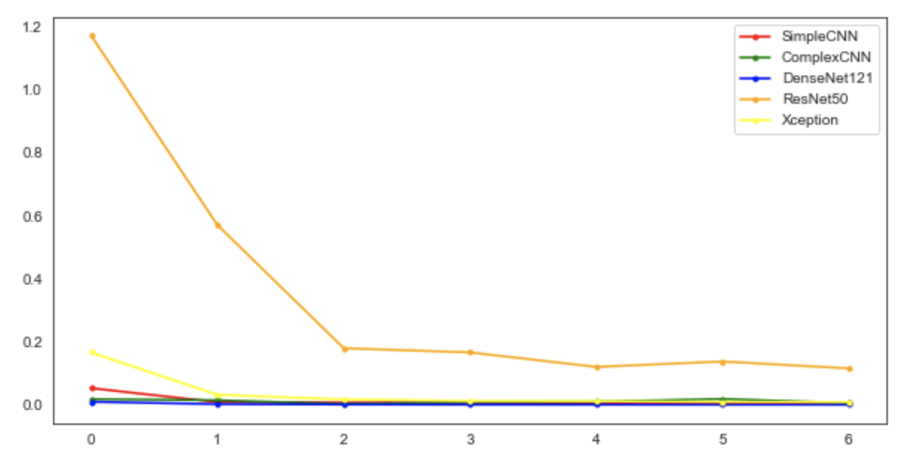
RESULT
Each model is run for 7 epochs
All the models are performing similarly, with Resnet as an exception.
DenseNet is the best performing model of all, But when compared with resources consumed Xception performs the best.

